Slide 1
DYSIDER (Dyslexia Aider)
K. Subhadharshini – 2018115113
V. Vishalini - 2018115132

Slide 2
Why have you chosen this project?
Dyslexia is a specific language disorder of neurobiological origin. The condition causes reading, writing and speaking issues amongst growing children.
It can be corrected with strategies geared to the innate strengths shared by dyslexic kids and individuals.
Through this project we aim to give engaging support to dyslexic kids.
With the help of appealing visual and textual aids, this application will help them improve their word recognition, vocabulary, spelling and decoding abilities.

Slide 3
Is your project available elsewhere?
On choosing this project, we began to search the internet for projects that have addressed the same condition.
But we couldn’t find any functional mobile or web application that gives a fun and engaging support for dyslexic kids, like how we had in mind.
Our project contains various modules, out of which some modules are inspired from existing games.

Slide 4
Design of your project.
Our project is a web application called ‘Dysider’.
It contains 5 different modules created to address the common issues faced by dyslexic children.
The modules are phonics, spelling, vowels, word formation and colours. As far as we have explored, these are the levels in which dyslexic kids commonly face issues in learning.
With the help of appealing visual and textual aids in each module, this application will help the kids improve their word recognition, vocabulary, spelling and decoding abilities.

Slide 5
Algorithms (if any)
No, we don’t have any algorithm implementation in our project.

Slide 6
What is the portion you have completed so far?
We have completed the website design of our project.
We have also completed the word formation module of our project. This module addresses the concept of word formation in two ways: speech practice feature and word formation anagram game.
We have also started working on the colour module of the project. All that we have completed so far comes to around 40% of the entire project.

Slide 7
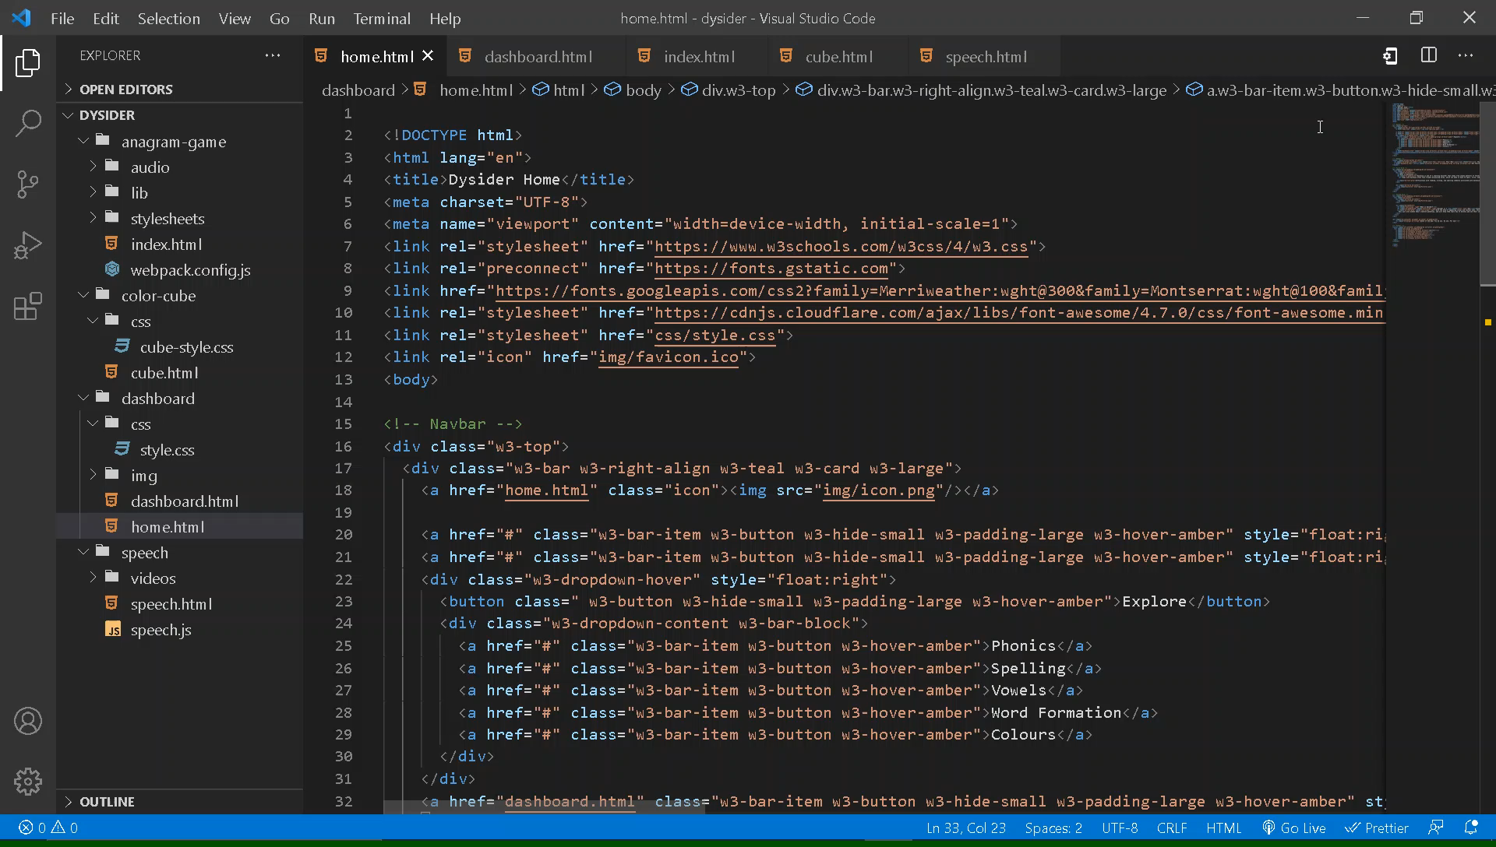

Slide 8
What is the role of each project member?
Since our project contains various modules, we have divided the work involved in developing each module amongst ourselves.
Subhadharshini, has completed the entire website design. She has also worked on the speech practice feature in the word formation module, and helped with anagram game in the same module.
Vishalini, has worked on the anagram game feature in the word formation module. She is also working on the colour module.

Slide 9
What is the innovation involved in your project?
With this project, we aim to help the dyslexic kids overcome commonly faced issues and increase their learning curve.
Since, sometimes plain teaching methods can get boring, we have planned to bring in a fun twist to learning, by including engaging games and visual aids.
Each module has features, that aim to address common problems faced by dyslexic kids, while kindling their creative potential.

Slide 10
Are you satisfied with your work. If yes, why? If no, why?
We are neither completely satisfied nor dissatisfied with our work.
Firstly, we aren’t completely satisfied because we started working on the project pretty late, because initially we spent most of the time researching.
But, we also aren’t entirely dissatisfied, because we have started working on various modules simultaneously, and they are coming together very well.

Slide 11
On 25, how will you evaluate your own work. Why?
We would give our work a 20 out of 25. The reason for the score is same as what we had discussed earlier.
Since we started late, work started to pile up, since we had to meet weekly deadlines.
But, since it is only the two of us, we are trying to give our fullest best to complete the project perfectly, and on time!

Slide 12
THE END

